Slide 1
Chapter One
Server Side Scripting

Slide 2
Outline
Introduction to server-side scripting
Server-side scripting languages
Use Basic Syntax
Write Comments
Utilize Variables
Manipulate Strings
Manipulate Numbers
Work with constants

Slide 3
Introduction
How does the web work (revision)?
It uses the HTTP (Hyper Text Transfer Protocol) to communicate between a client and a server
The request ranges from simple get request to fetch a static content to post and delete requests to add or delete resources on the server
Every request and response contains a header and optional body
Servers are always on and listen to requests from clients and handle them accordingly

Slide 4
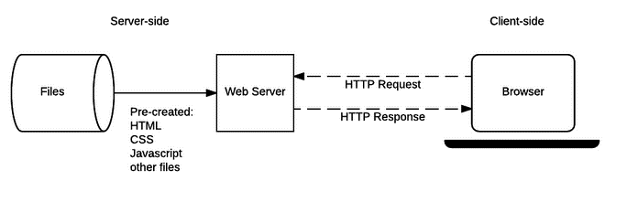
Cont...
Communication Scenarios
Static content
Notes:
Emma wants to check the menu of Sweet Bites Bakery, so she types sweetbites.com in her browser.
Her browser requests the homepage, and the server responds with a pre-created HTML file, along with CSS and JavaScript.
The "View Menu" button runs a script that simply displays a hardcoded message like:"Our menu includes cupcakes, croissants, and brownies!"
No new data is fetched from the server, and every visitor sees the same message, regardless of when they visit.

Slide 5
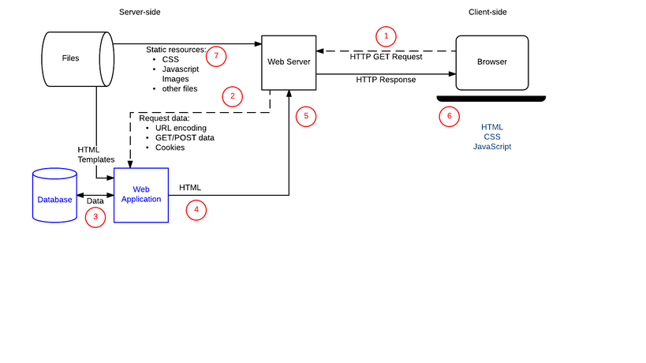
Cont...
Dynamic content
Notes:
Instead of displaying a fixed message, clicking "View Menu" sends a request to the server.
The server checks its database for the latest menu and sends back updated items.
If the bakery adds a new item, Emma will see it immediately without anyone manually updating the HTML file.

Slide 6
Server Side vs Client Side Scripting Languages
Client side scripts
Are executed by the client, particularly by the browser
They are used for appearance and behavior of a web page
It has little or no access to the underlying operating system
Some features may not work or may not be properly rendered on specific browser(s)
Notes:
Client-Side Script A streaming site personalizes a greeting using localStorage without needing a server response.
Executed by the Browser A clothing store changes T-shirt colors dynamically without needing a server response.
Appearance & Behavior A hotel booking site highlights selected rooms without needing a server response.
browsers can open local files through the file:/// protocol, they’re still sandboxed when it comes to interacting with the system beyond just displaying or reading content.

Slide 7
Server Side vs Client Side Scripting Languages
Server Side Scripting Language
A server-side scripting language is a script executed on the server, as opposed to client-side scripting languages like JavaScript.
It requires a server-side scripting engine
It has full access to the server's operating system
There are a variety of server-side scripting languages, including PHP, Python, Ruby, C#, and JavaScript (via Node.js), among others
Notes:
A server-side scripting engine is a software that interprets and executes server-side scripts to generate dynamic content for a web page.
When you visit a website built with PHP, the web server (e.g., Apache) hands the PHP file over to the PHP engine.
The PHP engine processes the PHP code, which could include interacting with a database, performing calculations, or generating dynamic HTML content.
After execution, the PHP engine sends the resulting HTML (or other content) back to the browser.

Slide 8
When to use server-side scripting
When developing Dynamic web pages
Authentication, authorization and session tracking.
Personalization and customization of content based on authentication and authorization. This also includes the serving of content based on the content of the page (e.g. YouTube, Amazon, Facebook) or the browsing behavior of the user.

Slide 9
When to use server-side scripting
Template-driven page generation. Including repeated content like header/footers and navigation menus around the “content area” of a web page.
Handling POST form input
Communication with other programs, libraries and APIs – e.g. sending out e-mail

Slide 10
What Is PHP?
PHP (Hypertext Protocol) is Open Source Programming Language used to make web pages.
PHP language can run on various platforms and is compatible with almost all servers.
PHP files use .php as their extension.
PHP can perform functions, like creating, opening, reading, writing, and closing files on a system
PHP can also perform functions like adding, deleting, and modifying elements within a database

Slide 11
What Is PHP?
PHP can restrict users from accessing some pages of your website
PHP can encrypt data too
PHP is widely-used, open-source language suited for web development.
PHP is free to download and runs on various platforms (Windows, Linux, macOS).
PHP is interpreted on the server before sending the result to the browser.
PHP requires a web server (e.g., Apache) or local development environment (e.g., XAMPP) to run.

Slide 12
The Apache Web Server
A web server is a type of computer software and its underlying hardware that accepts requests via HTTP or its secure variant HTTPS.
The Apache HTTP Server is a free and open-source cross-platform web server, released under the terms of Apache License 2.0.
Apache doesn’t serve up just HTML files—it handles a wide range of files, from images to MP3 audio files, RSS (Really Simple Syndication) feeds, and so on.
More importantly, these files don’t always have to be pre-existing static files; they can be dynamically generated using server-side programs like PHP.
Notes:
For example, If you use PHP's GD functions to generate an image in image.php and access it in a browser, Apache executes the script, dynamically creating and displaying the image with "Hello, PHP!" instead of loading a static .png file.

Slide 13
WAMP, MAMP, or LAMP?
WAMP, MAMP, and LAMP are software packages that help set up a local web server for development.
WAMP (Windows, Apache, MySQL, PHP) is for Windows.
MAMP (Mac, Apache, MySQL, PHP) is for Mac.
LAMP (Linux, Apache, MySQL, PHP) is for Linux.
They are easy to set up but are only for development and testing—not for live websites—because they are not secure enough for public use.
Notes:
XAMPP is a cross-platform that allows developers to test website content before uploading it online. WAMP is a local server developers benefit from when creating dynamic sites for Windows-based systems. Developers use the MAMP server to evaluate sites on Mac-based operating systems.

Slide 14
XAMPP
XAMPP is an open-source web server solution package.
It is mainly used for web application testing on a local host webserver.
XAMPP stands for:
X = Cross-platform
A = Apache Server
M = MariaDB/MySQL
P = PHP
P = Perl

Slide 15
Why do we need xampp?
Enables development and testing of websites on a local machine without requiring an internet connection or live server.
Provides PHP and MySQL/MariaDB support, for backend development and database integration.
Works on Windows, macOS, and Linux, ensuring flexibility across different operating systems.
Bundles Apache, MySQL, and PHP together, reducing the complexity of manual installation and configuration.
Allows testing websites and applications locally to catch errors before going live.

Slide 16
PHP Syntax
PHP code is placed between <?php and ?>.
One or more PHP code blocks can be embedded in an HTML file.
Case Sensitivity
Function names are not case-sensitive, but variable names are.
Example
<?php
$x = 5;
$y = 10;
echo $x + $y;
?>

Slide 17
PHP code blocks can be embedded in an HTML file
<!DOCTYPE html>
<html>
<head>
<title>PHP</title>
</head>
<body>
<h1>
<?php
echo "hii GeeksforGeeks "
?>
</h1>
</body>
</html>

Slide 18
PHP Comments
Single-Line Comments
// comment here
# comment here
Multi-Line Comments
/* multiple lines of comments here */
Usage
Use comments to explain code logic or temporarily disable code segments.

Slide 19
PHP Case Sensitivity
In PHP, keywords (e.g. if, else, while, echo, etc.), classes, functions, and user-defined functions ARE NOT CASE-SENSITIVE.
all three echo statements below are equal and legal:
<?php
ECHO "Hello World!<br>";
echo "Hello World!<br>";
EcHo "Hello World!<br>";
?>
Note: However; all variable names are case-sensitive!

Slide 20
PHP Variables
In PHP, a variable starts with the $ sign, followed by the name of the variable:
$x = 5;
$y = "John";
A variable name must start with a letter or the underscore character
A variable name cannot start with a number
A variable name can only contain alpha-numeric characters and underscores (A-z, 0-9, and _ )
Unlike other programming languages, PHP has no command for declaring a variable. It is created the moment you first assign a value to it.

Slide 21
PHP is a Loosely Typed Language
PHP automatically associates a data type to the variable, depending on its value.
Since the data types are not set in a strict sense, you can do things like adding a string to an integer without causing an error.
In PHP 7, type declarations were added.
This gives an option to specify the data type expected when declaring a function,
By enabling the strict requirement, it will throw a "Fatal Error" on a type mismatch

Slide 22
Variable Types
PHP has no command for declaring a variable, and the data type depends on the value of the variable.
$x = 5; // $x is an integer
$y = "John"; // $y is a string
echo $x;
echo $y;
PHP supports the following data types:
String, Integer, Float, Boolean, Array, Object, NULL, Resource

Slide 23
PHP Data Types
Strings: Text in quotes ("Hello World").
Integers: Non-decimal numbers (positive, negative, or zero).
Floats (Doubles): Decimal numbers or those in exponential form.
Booleans: True or false values.
Arrays: Collections of values in one variable.
Objects: Hold both data and methods related to that data.
NULL: Variable with no value assigned.
Resources: Special references (like database connections).

Slide 24
Revision questions
What is the difference between client side and server side scripting languages
Give examples of server side scripting languages
List out components of the “web”
Why do we need XAMPP?
How do you declare a variable in PHP?

Slide 25
PHP Variables Scope
In PHP, variables can be declared anywhere in the script.
The scope of a variable is the part of the script where the variable can be referenced/used.
PHP has three different variable scopes:
local
global
static

Slide 26
Global Scope
A variable declared outside a function has a GLOBAL SCOPE and can only be accessed outside a function
$x = 5; // global scope
function myTest() {
// using x inside this function will generate an error
echo "<p>Variable x inside function is: $x</p>";
}
myTest();
echo "<p>Variable x outside function is: $x</p>";

Slide 27
Local Scope
A variable declared within a function has a LOCAL SCOPE and can only be accessed within that function
function myTest() {
$x = 5; // local scope
echo "<p>Variable x inside function is: $x</p>";
}
myTest();
// using x outside the function will generate an error
echo "<p>Variable x outside function is: $x</p>";
Notes:
You can have local variables with the same name in different functions, because local variables are only recognized by the function in which they are declared.

Slide 28
PHP The global Keyword
The global keyword is used to access a global variable from within a function.
To do this, use the global keyword before the variables (inside the function):
$x = 5;
$y = 10;
function myTest() {
global $x, $y;
$y = $x + $y;
}
myTest();
echo $y; // outputs 15

Slide 29
PHP The global Keyword
PHP also stores all global variables in an array called $GLOBALS[index]. The index holds the name of the variable.
This array is also accessible from within functions and can be used to update global variables directly.
$x = 5;
$y = 10;
function myTest() {
$GLOBALS['y'] = $GLOBALS['x'] + $GLOBALS['y'];
}

Slide 30
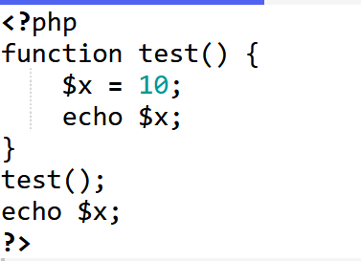
What will be the output

Slide 31
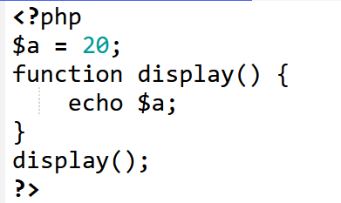
What will be the output

Slide 32
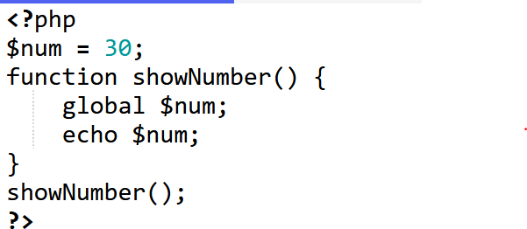
What will be the output

Slide 33
PHP Echo / Print
Echo
Outputs one or more strings, does not return a value.
Can handle multiple parameters separated by commas.
Print
Outputs a single string and always returns 1.
Slightly slower compared to echo in most cases.
Example
<?php
echo "Hello", " World!";
print "Hello World!";
?>

Slide 34
Control Structures in PHP

Slide 35
Control Structure
PHP has a number of control structures to change this default order of execution
Conditionals: Statements like if and switch that execute or skip statements depending on the value of an expression
Loops: Statements like while and for that execute other statements repetitively
Jumps: Statements like break, return, and throw that cause the interpreter to jump to another part of the program

Slide 36
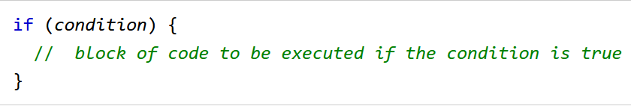
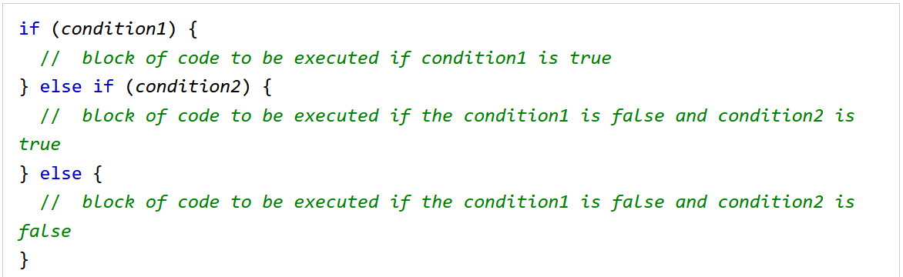
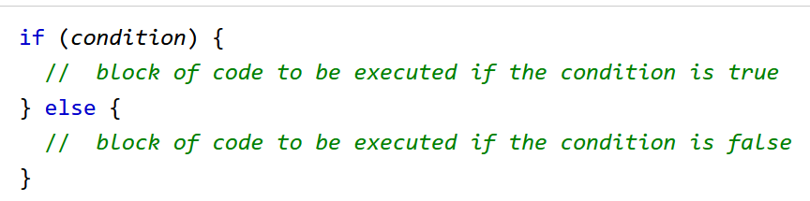
PHP if, else, and else if
Conditional statements are used to perform different actions based on different conditions.

Slide 37
Revision questions
Write a program that checks if a number is positive, negative, or zero. Log the result to the console.
Write a program that checks a student's grade and logs the performance level:
If the grade is 90 or above, log "Excellent".
If the grade is between 70 and 89, log "Good".
If the grade is between 50 and 69, log "Average".
Otherwise, log "Fail".

Slide 38
PHP For Loop
PHP supports different kinds of loops:
for - loops through a block of code a number of times
while - loops through a block of code while a specified condition is true
do/while - also loops through a block of code while a specified condition is true

Slide 39
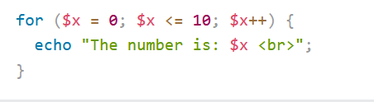
For loop
The for loop is used when the number of iterations is known. It consists of three parts: initialization, condition, and increment/decrement.
Syntax:
for (initialization; condition; increment/decrement)
{
// code block to execute
}

Slide 40
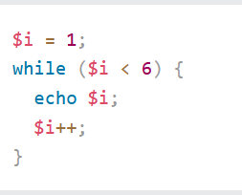
while Loop
The while loop executes as long as the specified condition evaluates to true.
Syntax:
while (condition)
{
// code block to execute
}

Slide 41
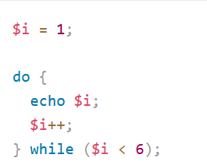
do...while Loop
The do...while loop executes the block of code once before checking the condition. It is guaranteed to execute at least once.
Syntax:
do {
// code block to execute
} while (condition);

Slide 42
takeaway question
Write a PHP program to print all even numbers between 1 and 100
Write a for loop that prints the numbers from 1 to 10, but skips 5
Write a while loop that prints numbers from 1 to 100

Slide 43
PHP Strings
Strings in PHP are surrounded by either double quotation marks, or single quotation marks.
Double quoted string literals perform operations for special characters:
$x = "John";
echo "Hello $x";
Single quoted strings does not perform such actions, it returns the string like it was written, with the variable name:
$x = "John";
echo 'Hello $x';

Slide 44
String Functions
The PHP strlen() function returns the length of a string.
echo strlen("Hello world!"); //12
The PHP str_word_count() function counts the number of words in a string.
echo str_word_count("Hello world!"); //2
The PHP strpos() function searches for a specific text within a string.
If a match is found, the function returns the character position of the first match. If no match is found, it will return FALSE.
echo strpos("Hello world!", "world"); //6
l

Slide 45
Takeaway questions
What will be the output of the following code:
$x = 5;
echo 'The price is $x';
What will be the output of echo strlen(" Learning PHP is fun");?
What will echo str_word_count(" PHP is awesome!"); output?
What does strpos(“Let's write some code!" ,“code") return?

Slide 46
PHP - Modify Strings
The strtoupper() function returns the string in upper case:
$x = "Hello World!";
echo strtoupper($x);
The strtolower() function returns the string in lower case:
$x = "Hello World!";
echo strtolower($x);
The PHP str_replace() function replaces some characters with some other characters in a string.
$x = "Hello World!";
echo str_replace("World", "Dolly", $x);

Slide 47
PHP - Modify Strings
The PHP strrev() function reverses a string.
$x = "Hello World!";
echo strrev($x);
The trim() removes any whitespace from the beginning or the end:
$x = " Hello World! ";
echo trim($x);
The PHP explode() function splits a string into an array.
The first parameter of the explode() function represents the "separator". The "separator" specifies where to split the string
$x = "Hello World!";
$y = explode(" ", $x);

Slide 48
Takeaway questions
What will be the output of the following code?
$x = " PHP is fun! ";
echo trim($x);
What will be the output?
$x = "apple,banana,orange";
$y = explode(",", $x);
Echo $y[0];
What will be the output of this code?
$x = "Hello World!";
echo str_replace("o", "0", $x);

Slide 49
PHP Casting
Cast Syntax
(int) $variable, (float) $variable, (bool) $variable, etc.
Usage
Ensures a value is treated as the desired data type.
Commonly done when mixing data from forms, URLs, or text to numeric operations.
Example
<?php
$var = "3.14";
$intVar = (int)$var; // becomes 3
?>

Slide 50
PHP Constants
A constant is an identifier (name) for a simple value. The value cannot be changed during the script.
A valid constant name starts with a letter or underscore (no $ sign before the constant name).
Unlike variables, constants are automatically global across the entire script.
To create a constant, use the define() function
define(name, value);
define("ROOT_LOCATION", "/usr/local/www/");
To read the contents of the variable, you just refer to it like a regular variable (but it isn’t preceded by a dollar sign):
$directory = ROOT_LOCATION;
Notes:
In other words, once you have defined a constant, its value is set for the remainder of the program and
cannot be altered

Slide 51
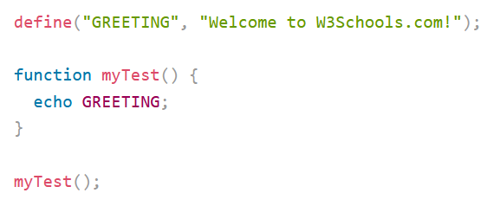
PHP Constants cont’d
Constants are automatically global and can be used across the entire script.

Slide 52
PHP Magic Constants
Predefined Constants
__LINE__ - Current line number.
__FILE__ - Full path and filename.
__DIR__ - Directory of the file.
__FUNCTION__, __CLASS__, __METHOD__, __NAMESPACE__.
Example
<?php
echo "This is line " . __LINE__ . " of file " . __FILE__;
?>
Notes:
The names of the magic constants always have two underscores at the beginning and two at the end, so that you won’t accidentally try to name one of your own constants with a name that is already taken

Slide 53
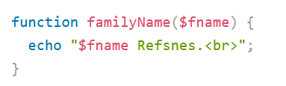
PHP Functions
PHP has more than 1000 built-in functions, and in addition you can create your own custom functions.
A function is a block of statements that can be used repeatedly in a program.
A function will not execute automatically when a page loads.
A function will be executed by a call to the function.
A user-defined function declaration starts with the keyword function, followed by the name of the function:

Slide 54
Passing Arguments
Passing by value
The original variable’s value will not be changed even if the recipient variable value is changed.
Passing by reference
is done by appending an ampersand to the front of the parameter(s).
It changes the original variable's value.
To pass by reference use & before the parameter name
Notes:
54

Slide 55
Default and Optional arguments
Default values can be assigned to input arguments, which will be automatically assigned to the parameter if no other value is provided.
E.g. function salestax($price,$tax=.0575)
You can designate certain arguments as optional by placing them at the end of the list and assigning them a default value of nothing.
function salestax($price,$tax="")

Slide 56
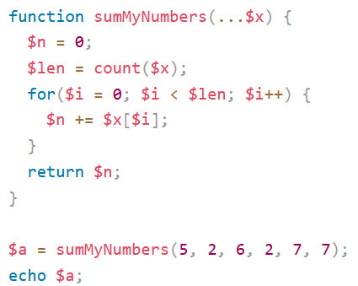
Variable Number of Arguments
By using the ... operator in front of a function parameter, a function accepts an unknown number of arguments.
This is also called a variadic function.
The variadic function argument becomes an array.

Slide 57
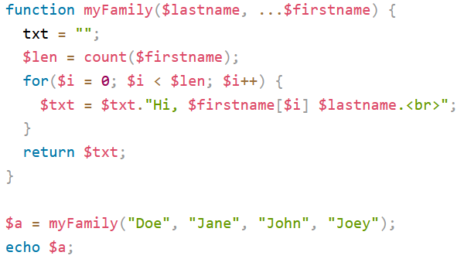
Variable Number of Arguments
You can only have one argument with variable length, and it has to be the last argument.
Notes:
Having the ... operator on the first of two arguments, will raise an error

Slide 58
In PHP 7, type declarations were added. This gives us an option to specify the expected data type when declaring a function,
When adding the strict declaration, if the data type mismatches, it will throw a "Fatal Error“.
<?php declare(strict_types=1);
function addNumbers(int $a, int $b) {
return $a + $b;
}
echo addNumbers(5, "5 days");
?>

Slide 59
Array
Array is a variable that can store more than one value. There are two ways used to create an array.
Informally
you can create the array simply by making reference to it.
$state[0] = "Delaware";
Formally
Uses the array() function
array array([item1 [,item2 ... [,itemN]]])
$languages = array ("English", "Gaelic", "Spanish");
$languages = array ("Spain" => "Spanish","Ireland" => "Gaelic", "United States" => "English");

Slide 60
Indexed arrays
There are two ways to create indexed arrays.
$cars = array("Volvo", "BMW", "Toyota");
Or
$cars[0] = "Volvo";
$cars[1] = "BMW";
$cars[2] = "Toyota"

Slide 61
Associative Arrays
Associative arrays are arrays that use named keys that you assign to them.
There are two ways to create an associative array:
$age = array("Peter"=>"35", "Ben"=>"37", "Joe"=>"43");
Or
$age['Peter'] = "35";
$age['Ben'] = "37";
$age['Joe'] = "43";

Slide 62
Array functions
range()
The range() function provides an easy way to quickly create and fill an array consisting of a range of low and high integer values.
$die = range(0,6);
Same as specifying $die = array(0,1,2,3,4,5,6)
The optional step parameter offers a convenient means for determining the increment between members of the range.
$even = range(0,20,2);
also be used for character sequences
$letters = range("A","F");
Notes:
62

Slide 63
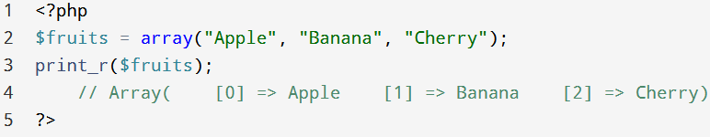
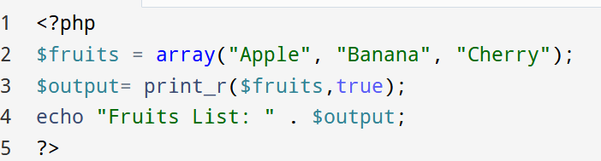
Outputting Array
print_r() is used to print the structure of arrays and objects in an easy-to-read format.
Example:
To capture the output of print_r(), the return parameter is used.
When this parameter is set to true, print_r() will return the information rather than print it.
Notes:
63
63

Slide 64
Adding and Removing array elements
array_push()
The array_push() function adds variable onto the end of the target_array.
$states = array("Ohio","New York");
array_push($states,"California","Texas");
array_pop()
The array_pop() function returns the last element from target_array.
$states = array("Ohio","New York","California","Texas");
$state = array_pop($states); // $state = "Texas"

Slide 65
Adding and Removing array elements
array_shift()
The array_shift() function is similar to array_pop(), except that it returns the first array item found on the target_array rather than the last.
$states = array("Ohio","New York","California","Texas");
$state = array_shift($states);
array_unshift()
The array_unshift() function is similar to array_push(), except that it adds elements to the front of the array rather than to the end.
$states = array("Ohio","New York");
array_unshift($states,"California","Texas");

Slide 66
Takeaway question 1
Given the following array, $fruits = ["apple", "banana"];
Perform the following operations in order:
Add "cherry" and "date" to the end of the array.
Remove the last element from the array.
Add "grape" to the beginning of the array.
Remove the first element from the array.
Finally, print the modified array. What is the expected output?

Slide 67
Takeaway question 2
What will be the output of the following PHP code?
$numbers = [10, 20, 30];
array_push($numbers, 40);
array_unshift($numbers,5);
array_pop($numbers);
array_shift($numbers);
array_push($numbers, 50);
array_unshift($numbers, 1);
print_r($numbers);

Slide 68
Adding and Removing array elements
array_pad()
The array_pad() function is used to expand an array to a specified length by adding a specified value either at the beginning or the end.
Syntax: array_pad($array, $size, $value)
$array – The original array.
$size – The desired total length of the array:
If $size is positive, padding is added to the end of the array.
If $size is negative, padding is added to the beginning of the array.
$value – The value used for padding.

Slide 69
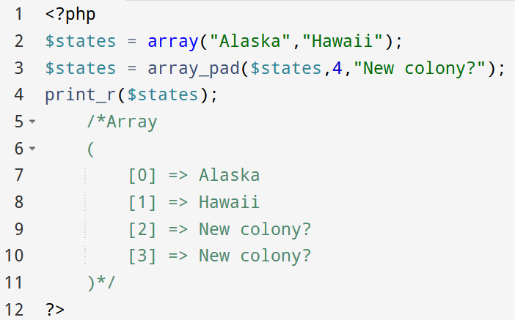
Adding and Removing array elements
array_pad()
The array_pad() function modifies the target array, increasing its size to the length specified by length.

Slide 70
Locating array elements
Array_keys()
returns an array consisting of all keys located in the array target array.
Syntax: array_keys($array, $search_value, $strict)
$array – The input array.
$search_value (optional) – If provided, array_keys() will return only the keys of elements matching this value.
$strict (optional) – If true, it will use strict comparison (===) when searching for values.
array_keys() does not modify the original array. It only returns a new array containing all the keys from the original array.

Slide 71
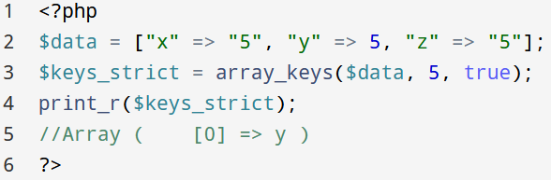
Locating array elements
Array_keys()
array_keys($array, $search_value, $strict)

Slide 72
Locating array elements
array_key_exists()
returns TRUE if the supplied key is found in the array target_array, and returns FALSE otherwise.
$fruits= ["a" => "Apple", "b" => "Banana", "c" => "Cherry"];
array_key_exists($keyToCheck, $arrayName);
array_key_exists(“b”, $fruits); //1

Slide 73
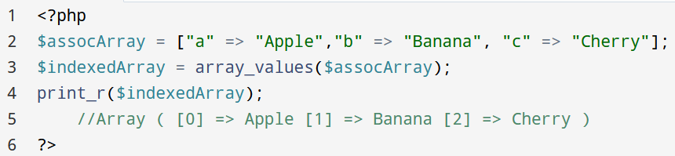
Locating array elements
array_values()
The array_values() function returns all values located in the target array, automatically providing numeric indexes for the returned array.
array_values() returns a new indexed array containing all the values from the original array

Slide 74
Locating array elements
array_search()
searches the array for a given value and returns the first corresponding key if successful
Syntax: array_search($needle, $haystack, $strict)
$needle – The value to search for
$haystack – The array to search in
$strict (optional) – If true, the search will use strict comparison (===)
$key = array_search("Banana", $ assocArray);

Slide 75
Takeaway questions
Given the array, $data = ["a" => 10, "b" => 20, "c" => 30];
Extend it to 5 elements, filling new slots with 0;
What will be the output of array_keys($data)?
Write a PHP condition to check if "b" exists as a key in $data.
What will be the output of array_values($data)?
Write a PHP statement to find the key of 30 in $data.

Slide 76
Traversing array
Using foreach loop
$colors=[“blue”,”yellow”,”red”];
foreach ($colors as $value)
{
echo "$value <br>";
}
$person = ["name" => "Alice", "age" => 25, "city" => "New York"];
foreach ($person as $key => $value)
{
echo "$key: $value\n";
}

Slide 77
Determine Array size and uniqueness
count()
count(input_array)
returns the total number of values found in the input_array.
Sizeof() function can be also used.
array_count_values()
returns an array consisting of associative key/value pairs.
Each key represents a value found in the input_array, and its corresponding value denotes the frequency of that key’s appearance (as a value) in the input_array.
E.g. $states = ["Ohio", "Iowa", "Ohio", "Arizona", "Iowa"];
$countedValues = array_count_values($states)
//output: Array ( [Ohio] => 2 [Iowa] => 2 [Arizona] => 1 )

Slide 78
Sorting Array
sort()
sorts the target_array, ordering elements from lowest to highest value.
rsort()
is identical to sort(), except that it sorts array items in reverse (descending) order.
asort()
is identical to sort(), sorting the target_array in ascending order, except that the key/value correspondence is maintained.
ksort()
sorts the input array array by its keys, returning TRUE on success and FALSE otherwise.
krsort()
operates identically to ksort(), sorting by key, except that it sorts in reverse (descending) order.
Notes:
The sort() function sorts an indexed array (or an associative array by values) in ascending order, but unlike asort(), it reindexes the array keys (losing the original associations).
$fruits = [ "b" => "Banana", "a" => "Apple", "d" => "Dragonfruit", "c" => "Cherry"];
sort($fruits);
print_r($fruits);
Array( [0] => Apple [1] => Banana [2] => Cherry [3] => Dragonfruit)

Slide 79
Merging, Slicing, splicing and Dissecting
array_combine()
array array_combine(array keys, array values)
produces a new array consisting of keys residing in the input parameter array keys, and corresponding values found in the input parameter array values.
both input arrays must be of equal size, and that neither can be empty.
E.g. $abbreviations = array("AL","AK","AZ","AR");
$states = array("Alabama","Alaska","Arizona","Arkansas");
$stateMap = array_combine($abbreviations,$states);

Slide 80
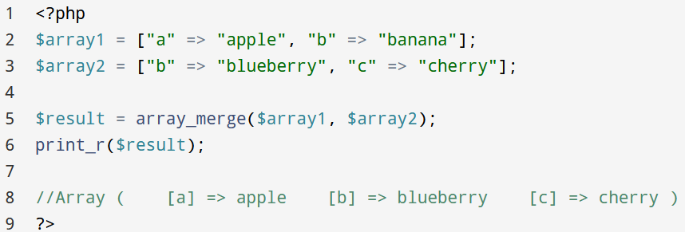
Merging, Slicing, Splicing and Dissecting
array_merge()
function used to merge two or more arrays into one.
Syntax: array_merge(...$arrays)
If an input array contains a string key that already exists in the resulting array, that key/value pair will overwrite the previously existing entry.

Slide 81
Merging, Slicing, splicing and Dissecting
array_slice()
Syntax: array_slice($array, $offset, $length, $preserve_keys)
Returns an extracted portion of an array while preserving the keys (if preserve_keys is set to true)
$array – The input array.
$offset – The starting index (0-based). A negative value counts from the end.
$length (optional) – The number of elements to extract. If omitted, it extracts till the end.
$preserve_keys (optional, default: false) – Whether to preserve original keys (true) or reindex them (false).

Slide 82
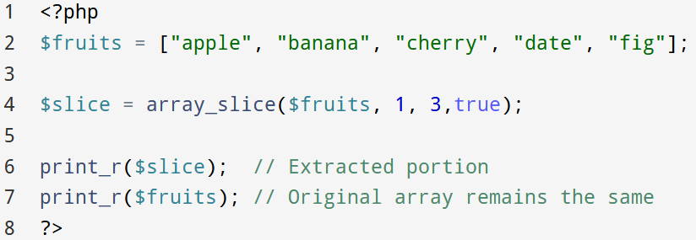
Merging, Slicing, splicing and Dissecting
array_slice()
Syntax: array_slice($array, $offset, $length, $preserve_keys)

Slide 83
Merging, Slicing, splicing and Dissecting
array_splice()
is used to remove, replace, or insert elements in an array. Unlike array_slice(), it modifies the original array.
Syntax: array_splice(&$array, $offset, $length, $replacement)
$array (by reference) – The input array that will be modified.
$offset – The starting index (0-based). A negative value counts from the end.
$length (optional) – The number of elements to remove. If omitted, it removes all elements from $offset onward.
$replacement (optional) – If provided, these values replace the removed elements.

Slide 84
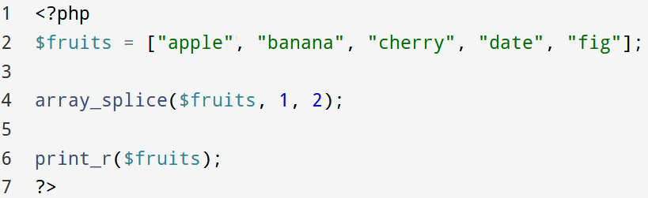
Merging, Slicing, splicing and Dissecting
array_splice()
Syntax: array_splice(&$array, $offset, $length, $replacement)
Example (removing elements)
Notes:
Array( [0] => apple [1] => date [2] => fig)

Slide 85
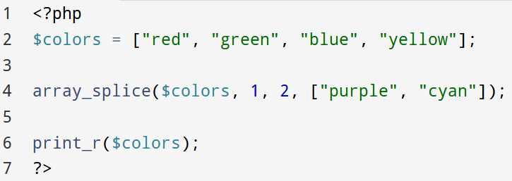
Merging, Slicing, splicing and Dissecting
array_splice()
Syntax: array_splice(&$array, $offset, $length, $replacement)
Example (replacing elements)
Notes:
Array( [0] => red [1] => purple [2] => cyan [3] => yellow)

Slide 86
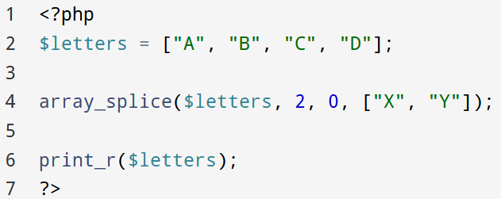
Merging, Slicing, splicing and Dissecting
array_splice()
Syntax: array_splice(&$array, $offset, $length, $replacement)
Example (inserting elements without removing)
Notes:
Array( [0] => A [1] => B [2] => X [3] => Y [4] => C [5] => D)

Slide 87
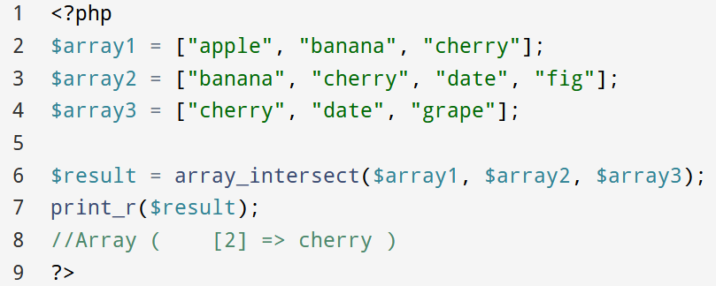
Merging, Slicing, splicing and Dissecting
array_intersect() is used to find common values between two or more arrays. It returns an array containing all the values that exist in all the input arrays

Slide 88
End of chapter 1

